Slide 1
Lecture III
Linear Inverse Problems

Slide 2
1.
The Relation between Bayesian Inference and Least Squares
Dear Lord, please make the world linear and normally distributed.
Statistician’s prayer

Slide 3
Derivation of the least-squares problem from Bayes’ theorem

Slide 4
2.
The Least Squares Solution

Slide 5


Least Squares In More Detail
We return to the least-squares misfit functional:
Interestingly, this can be written in a much simpler form:
The posterior mean model
minimises the least-squares misfit and is often [somewhat incorrectly] regarded as the least-squares solution.
The posterior model covariance
describes how well the solution is constrained.
A large posterior covariance means that the solution is poorly constrained [quite different models lead to only slightly higher misfit] and vice versa.

Slide 6
Least Squares In More Detail
We return to the least-squares misfit functional:
Interestingly, this can be written in a much simpler form:
The posterior mean model
minimises the least-squares misfit and is often [somewhat incorrectly] regarded as the least-squares solution.
The posterior model covariance
describes how well the solution is constrained.
A large posterior covariance means that the solution is poorly constrained [quite different models lead to only slightly higher misfit] and vice versa.

Slide 7
Least Squares In More Detail
We return to the least-squares misfit functional:
Interestingly, this can be written in a much simpler form:
The posterior mean model
minimises the least-squares misfit and is often [somewhat incorrectly] regarded as the least-squares solution.
The posterior model covariance
describes how well the solution is constrained.
A large posterior covariance means that the solution is poorly constrained [quite different models lead to only slightly higher misfit] and vice versa.

Slide 8
Some Comments
The solution to the least-squares problem is fully described by the posterior mean model and the posterior covariance.
Both can in principle be computed explicitly. This makes least-squares so attractive.
All this rests on the assumption that the forward problem is linear.
One may need to invert a large matrix.
The matrix may actually not be invertible.

Slide 9
3.
Model Problem: Linear Traveltime Tomography

Slide 10
Model Problem For Illustration
To better illustrate the least-squares concept, we consider a simple toy problem:
2-D straight-ray traveltime tomography,
11 sources and 21 receivers connected by 231 straight rays,
21 × 21 = 441 blocks of constant slowness used to parameterise the model.

Slide 11
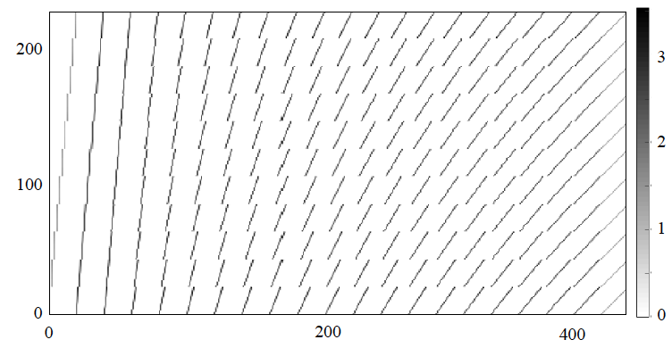
Model Problem For Illustration
The forward problem is exactly linear: d=Gm.
The model vector m contains the slowness values in the blocks.
The matrix G contains the lengths of the ray segments in each block.
The problem is under-determined because we have more unknowns (441) than observations (231).
Though coverage looks good, G is extremely sparse, and only around 200 of the 441 eigenvalues of G^{T}G are non-zero.
Fig: Visualisation of G

Slide 12
Inverse Crime
In order to have some ground-truth solution, we commit an inverse crime, i.e., we compute artificial data for some input slowness model:

Slide 13
4.
Prior Knowledge vs. Regularisation

Slide 14

A Crime Within The Crime
Obviously, the least-squares problem cannot be solved unless we inject prior knowledge.
But what prior knowledge do we honestly have? What if this is still not enough?
Regularisation = injection of artificial prior knowledge with the pragmatic goal to make a matrix invertible [well conditioned].
It is inherently an act of subjectivity. There is no universally good regularisation.
In tomography, regularisation is often implemented via a designed prior model covariance:
where σM describes how well we know individual parameters, and λ describes correlations between neighbouring parameters.
This causes two different kinds of regularisation:
Damping (via σM)
Smoothing (via λ)

Slide 15
A Crime Within The Crime
Obviously, the least-squares problem cannot be solved unless we inject prior knowledge.
But what prior knowledge do we honestly have? What if this is still not enough?
Regularisation = injection of artificial prior knowledge with the pragmatic goal to make a matrix invertible [well conditioned].
It is inherently an act of subjectivity. There is no universally good regularisation.
In tomography, regularisation is often implemented via a designed prior model covariance:
where σM describes how well we know individual parameters, and λ describes correlations between neighbouring parameters.
This causes two different kinds of regularisation:
Damping (via σM)
Smoothing (via λ)

Slide 16
A Crime Within The Crime
Obviously, the least-squares problem cannot be solved unless we inject prior knowledge.
But what prior knowledge do we honestly have? What if this is still not enough?
Regularisation = injection of artificial prior knowledge with the pragmatic goal to make a matrix invertible [well conditioned].
It is inherently an act of subjectivity. There is no universally good regularisation.
In tomography, regularisation is often implemented via a designed prior model covariance:
where σM describes how well we know individual parameters, and λ describes correlations between neighbouring parameters.
This results in two different kinds of regularisation:
Damping (via σM)
Smoothing (via λ)

Slide 17
Inverse Crime
In order to have some ground-truth solution, we commit an inverse crime, i.e., we compute artificial data for some input slowness model:
Target model
σM=2e-5 s/m and λ=7.5 m

Slide 18
Inverse Crime
In order to have some ground-truth solution, we commit an inverse crime, i.e., we compute artificial data for some input slowness model:
Target model
σM=2e-5 s/m and λ=7.5 m
Least-squares solution
σM=2e-5 s/m and λ=7.5 m

Slide 19
Choosing A Reasonable Regularisation
There is no perfect regularisation.
But we can choose a reasonable regularisation by looking at its influence on data fit and model complexity.

Slide 20
Choosing A Reasonable Regularisation
There is no perfect regularisation.
But we can choose a reasonable regularisation by looking at its influence on data fit and model complexity.

Slide 21
5.
Resolution

Slide 22
Derivation of the resolution matrix

Slide 23
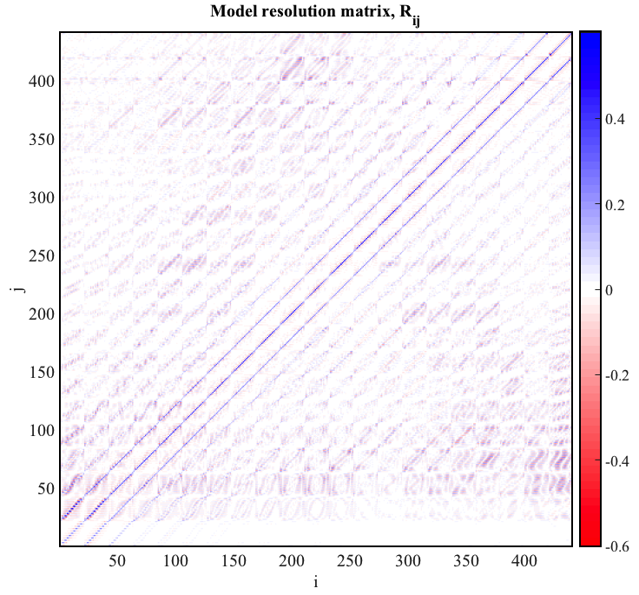
The Resolution Matrix

Slide 24
Derivation of the point-spread function

Slide 25
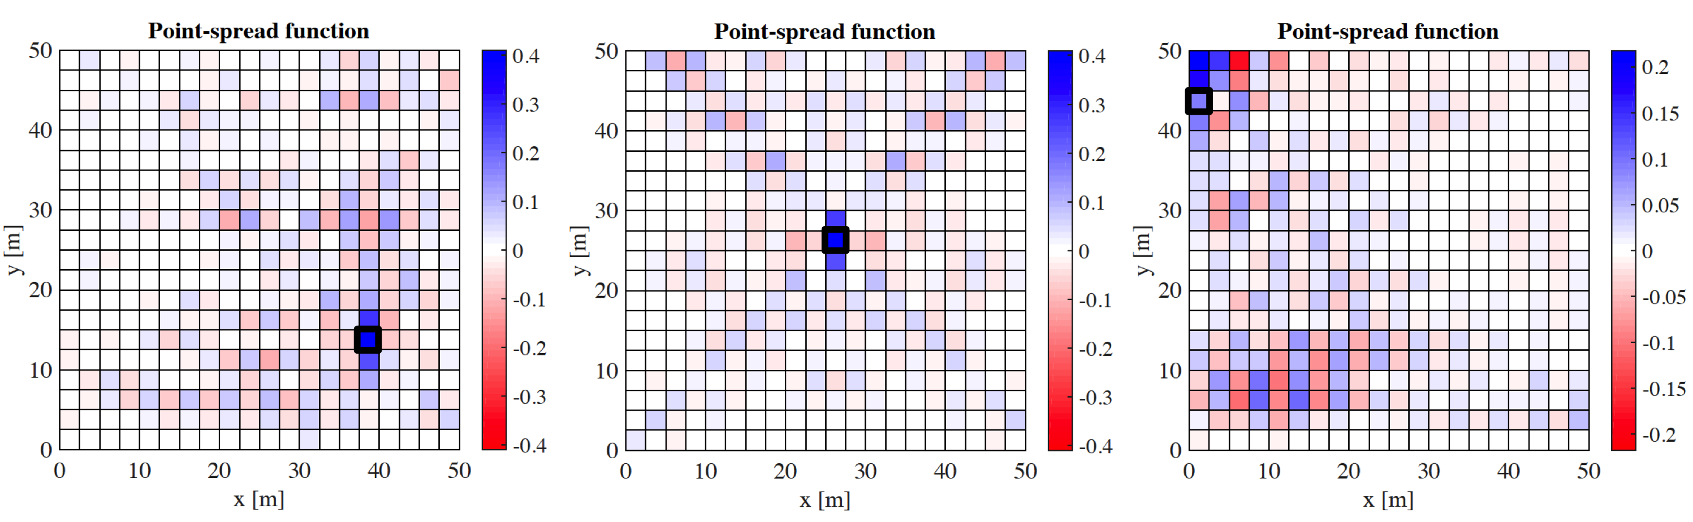
Point-Spread Functions And Averaging Kernels
Columns of the resolution matrix: point-spread functions

Slide 26
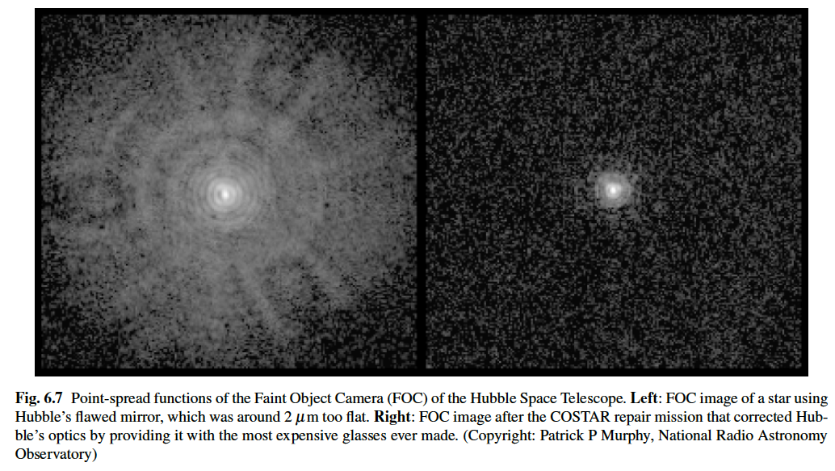
Point-Spread Functions And Averaging Kernels

